Slide 1

Use of Energy Storage to Improve Power System Inertia (A Virtual Inertia System)
Final Presentation
GROUP MEMBERS -
Janindu Gallage - 170172R
Buddhima Medawatta - 170384T
Dilshan Perera - 170439T
GROUP SUPERVISOR -
Dr. Asanka Rodrigo

Slide 2

Introduction
Due to the current environmental concerns, the importance of renewable energy has been greatly increased in a short period of time.
But due to the intermittent nature of renewables, the grid requires a mix of conventional and renewable sources.

Slide 3
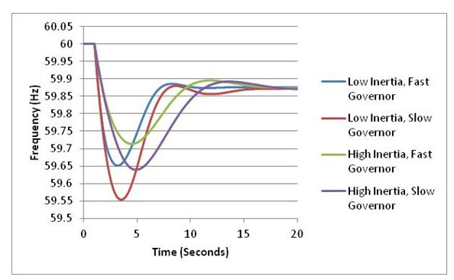
Introduction
The integration of renewables results in reduced grid stability due to their negligible or lack of inertia.
To fully utilize the potential of renewables while maintaining grid stability, it is important to find a method to improve grid inertia under renewable integration.

Slide 4
Objectives
The objective of this project is to design a control system that can control the power injected to the grid during disturbances and analyze its capability to support the stabilization.
Design a control system that can
Measure the disturbance
Control the power injected to the grid
Evaluate the virtual inertia system’s performance
We start with the proposition that we can use energy storage to emulate inertia and develop a method to deploy that energy to improve inertia

Slide 5
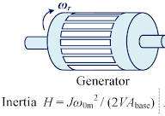
Inertia and its effects
When the electrical power output of a synchronous generator is greater than its mechanical power input, the rotor starts to slow down and converts the kinetic energy to electrical energy. This results in a drop of output voltage frequency
The moment of inertia of the generator resists deceleration and reduces the frequency drop and allows the governor to achieve steady state operation easily.
A low inertia grid is likely to experience higher frequency deviations due to disturbances due to this effect
With the current trend of increasing renewable integration. The equivalent inertia constant of a grid is likely to be reduced
This effect occurs due to the lack of inherently deployable energy storages of renewable sources unlike synchronous generators
Microgrids with a combination of synchronous generators with a high degree of renewable integration are very likely to possess a low inertia constant.

Slide 6
Concept of virtual inertia
The kinetic energy associated with a synchronous generator set is expended during power imbalances and causes frequency fluctuations
It is theoretically possible to use a sperate energy storage to represent the kinetic energy stored in the rotor of a synchronous generator, this is known as virtual kinetic energy storage.
By injecting this stored energy into the grid during a disturbance, it is possible to reduce the kinetic energy expended by the rotors
This results in reduced frequency fluctuations due to the declaration and acceleration of the rotors.
The most important aspect of such a system is the controlling mechanism that measures the disturbance and controls the power supplied to the grid.

Slide 7
Summary of Literature
In literature regarding virtual inertia systems, two main methods of operations were observed
The most common approach is the numerical solving of the swing equation to calculate the virtual shaft angular velocity.
This is then integrated to control the phase angle of the virtual inertia system/ Virtual synchronous generator.
This method closely imitates the dynamics of a real synchronous generator and damping action can be incorporated easily
An example for this approach is shown in the following paper

Slide 8
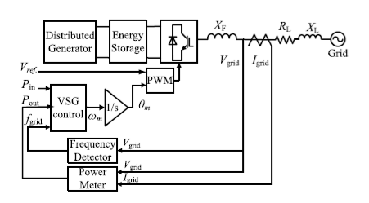
From research paper - J. Alipoor, Y. Miura and T. Ise, "Power System Stabilization Using Virtual Synchronous Generator With Alternating Moment of Inertia,
Here the VSG control numerically solves the swing equation to obtain the virtual shaft speed which is integrated to obtain the shaft angle which will act as the reference angle that the PWM will execute.
The alternating inertia action described in this paper was adapted to our system

Slide 9
The other method that is described in papers uses the rate of change of change of frequency to calculate the power injected to the grid.
In this method, the swing equation is not numerically solved to calculate the virtual shaft angle
Frequency measurement is taken directly from the grid and the power to be injected is calculated.
These systems theoretically offer faster response because the absence of an integral function. Because unlike integrals of bounded functions, derivatives of bounded functions can make step changes.
An example of this method is shown in the following paper.

Slide 10
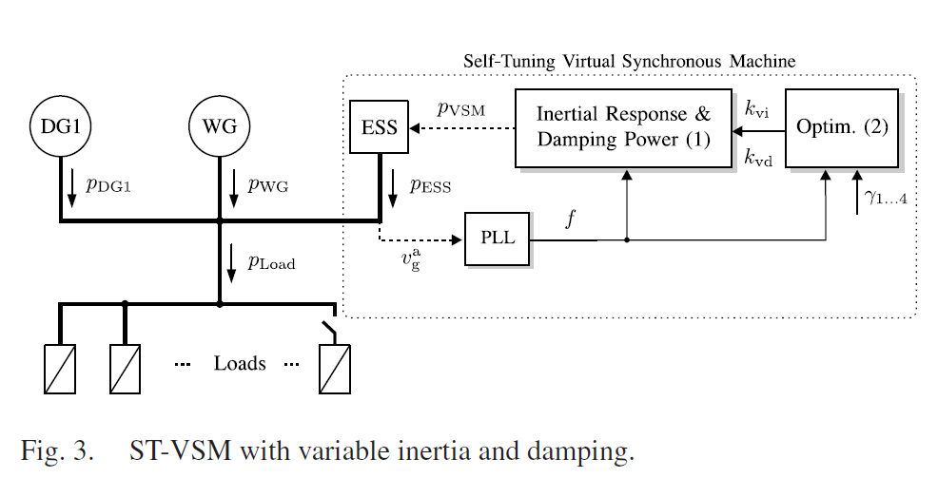
From research paper- M. A. Torres L., L. A. C. Lopes, L. A. Morán T. and J. R. Espinoza C., "Self-Tuning Virtual Synchronous Machine: A Control Strategy for Energy Storage Systems to Support Dynamic Frequency Control
Here the control equation used directly measures the rate of change of frequency and the power to be injected is calculated from this.
This method is similar to our initial design and justifies our approach as a viable alternative to the previous method

Slide 12
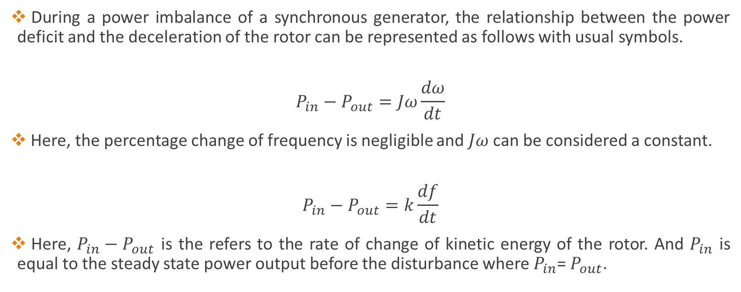
Control Equation and Technique
During a power imbalance of a synchronous generator, the relationship between the power deficit and the deceleration of the rotor can be represented as follows with usual symbols.
$$P_{in}−P_{out}=Jω\frac{dω}{dt}$$
Here, the percentage change of frequency is negligible and $Jω$ can be considered a constant.
$$P_{in}−P_{out}=k\frac{df}{dt}$$
Here, $P_{in}−P_{out}$ is the refers to the rate of change of kinetic energy of the rotor. And $P_{in}$ is equal to the steady state power output before the disturbance where $P_{in}$= $P_{out}$.

Slide 13
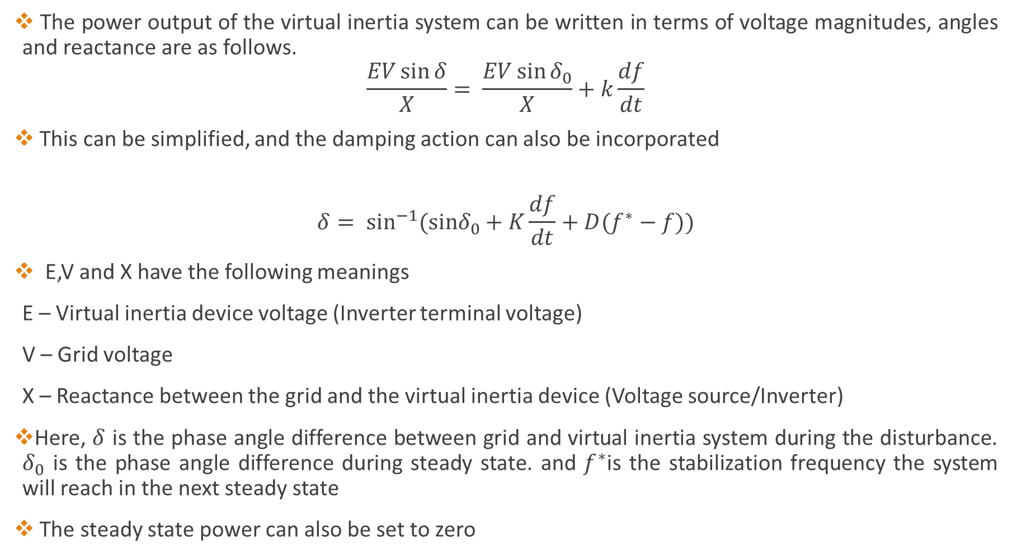
The power output of the virtual inertia system can be written in terms of voltage magnitudes, angles and reactance are as follows.
$$\frac{EV\sin{δ}}{X}= \frac{EV\sin{δ_{0}}}{X}+k\frac{df}{dt}$$
This can be simplified, and the damping action can also be incorporated
$$δ= \sin^{−1}{(sinδ_{0}+K\frac{df}{dt}+D(f^{∗}−f))}$$
E,V and X have the following meanings
E – Virtual inertia device voltage (Inverter terminal voltage)
V – Grid voltage
X – Reactance between the grid and the virtual inertia device (Voltage source/Inverter)
Here, $δ$ is the phase angle difference between grid and virtual inertia system during the disturbance. $δ_{0}$ is the phase angle difference during steady state. and $f^{∗}$is the stabilization frequency the system will reach in the next steady state
The steady state power can also be set to zero

Slide 14
The concept of alternating inertia
The inertia of a system resists both accelerations and decelerations. A high inertia system reduces the initial frequency drop (Increases frequency nadir). But also resists the when the system returns to its steady state value.
The inherent inertia of a system is a constant, so this can be considered as a trade off associated with a high inertia system
However, a virtual inertia system can vary its inertia effect simply by adjusting the parameters controlling its inertia

Slide 15
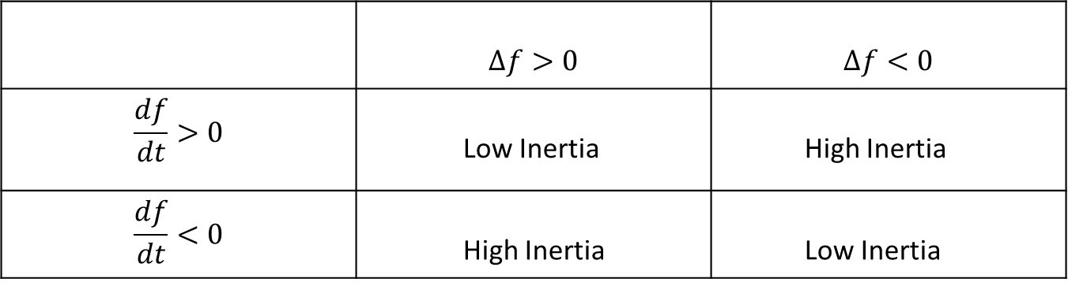

This alternating/dynamic inertia strategy can be defined as follows where $f_{0}$ represents the nominal frequency
$$∆f=f_{0}−f$$
 | $$∆f>0$$ | $$∆f<0$$
$$\frac{df}{dt}>0$$ | Low Inertia | High Inertia
$$\frac{df}{dt}<0$$ | High Inertia | Low Inertia

Slide 16
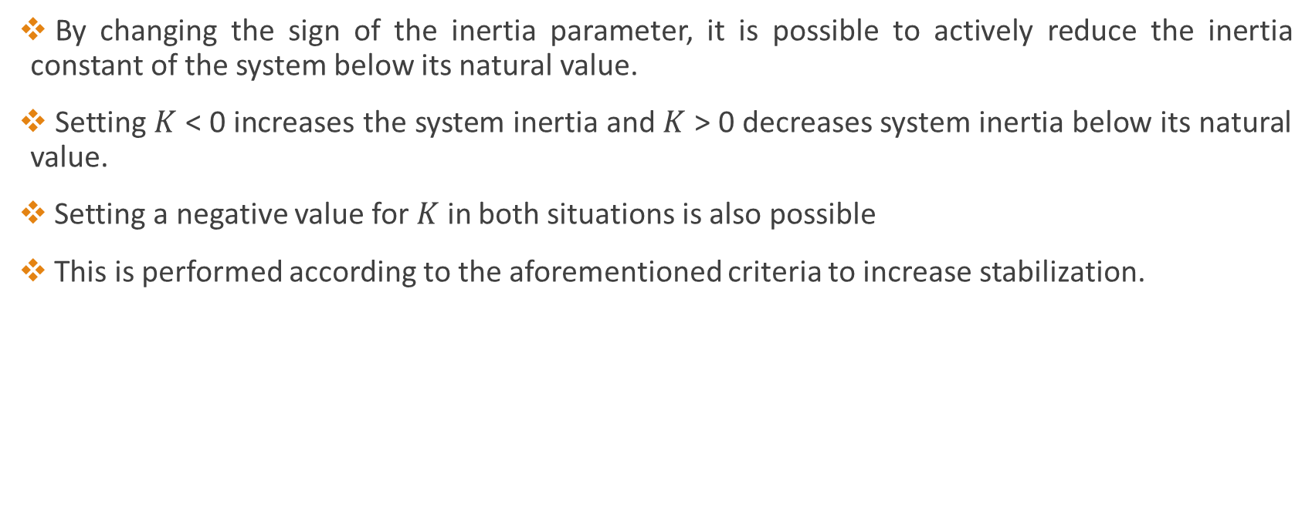
By changing the sign of the inertia parameter, it is possible to actively reduce the inertia constant of the system below its natural value.
Setting $K$ < 0 increases the system inertia and $K$ > 0 decreases system inertia below its natural value.
Setting a negative value for $K$ in both situations is also possible
This is performed according to the aforementioned criteria to increase stabilization.

Slide 17
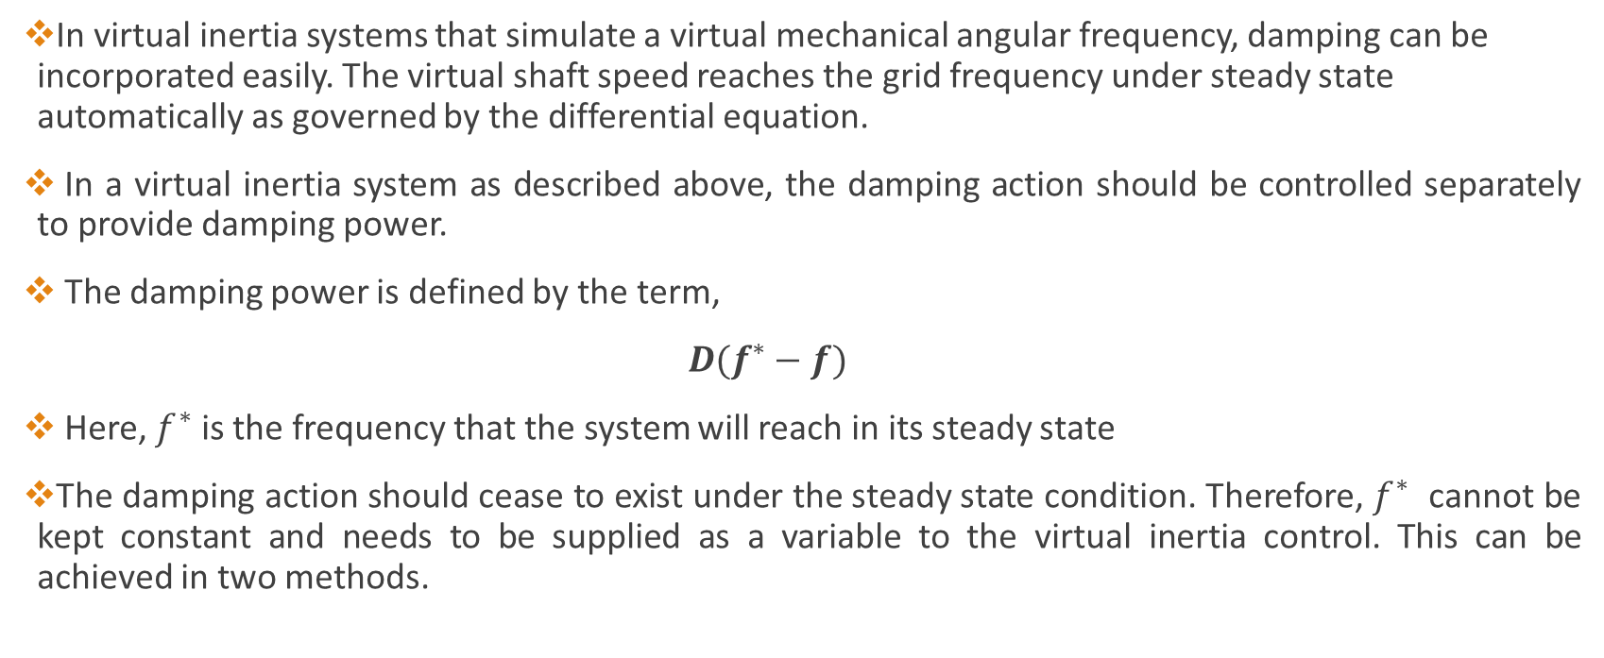
Controlling the damping action
In virtual inertia systems that simulate a virtual mechanical angular frequency, damping can be incorporated easily. The virtual shaft speed reaches the grid frequency under steady state automatically as governed by the differential equation.
In a virtual inertia system as described above, the damping action should be controlled separately to provide damping power.
The damping power is defined by the term,
$D(f^{∗}−f)$
Here, $f^{∗}$ is the frequency that the system will reach in its steady state
The damping action should cease to exist under the steady state condition. Therefore, $f^{∗}$ cannot be kept constant and needs to be supplied as a variable to the virtual inertia control. This can be achieved in two methods.

Slide 18
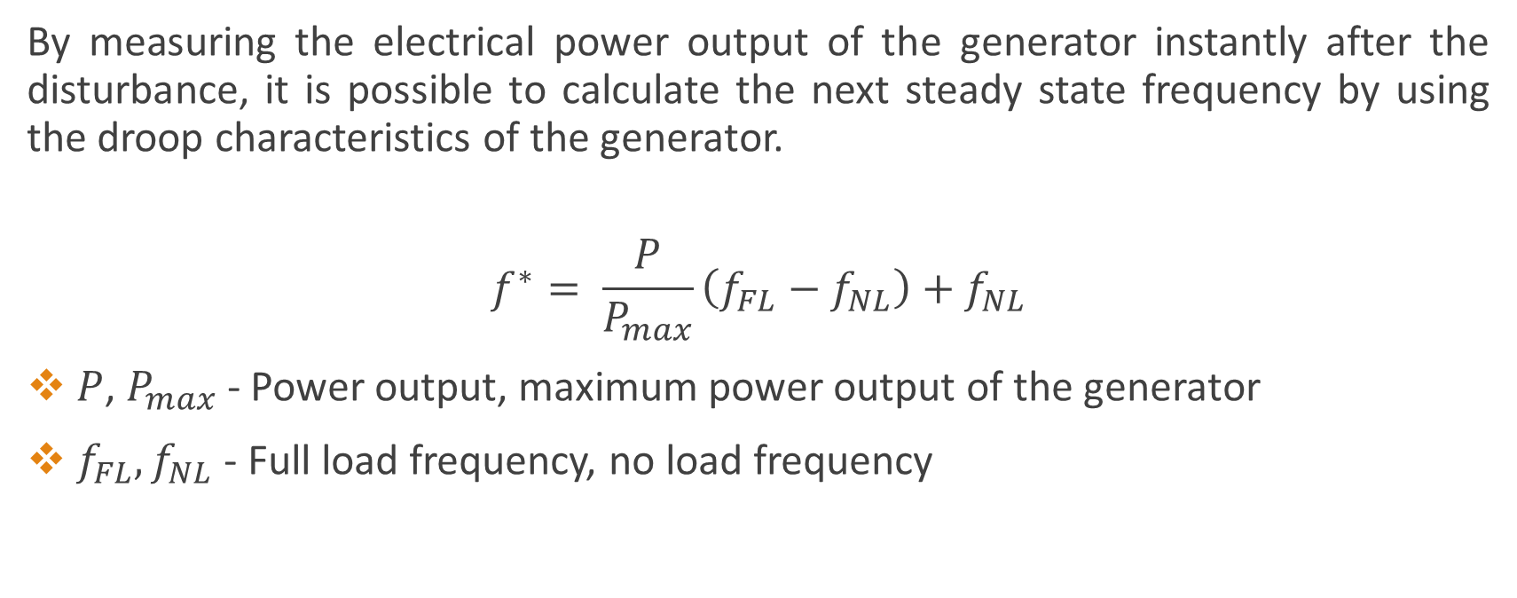
Method I
By measuring the electrical power output of the generator instantly after the disturbance, it is possible to calculate the next steady state frequency by using the droop characteristics of the generator.
$$f^{∗}= \frac{P}{P_{max}}\left(f_{FL}−f_{NL}\right)+f_{NL}$$
$P$, $P_{max}$ - Power output, maximum power output of the generator
${ f}_{FL},f_{NL}$ - Full load frequency, no load frequency

Slide 19
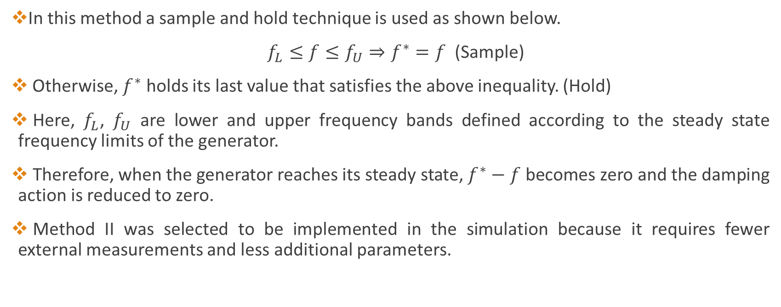
Method II
In this method a sample and hold technique is used as shown below.
$f_{L}≤f≤f_{U}⇒f^{∗}=f$ (Sample)
Otherwise, $f^{∗}$ holds its last value that satisfies the above inequality. (Hold)
Here, $f_{L}$, $f_{U}$ are lower and upper frequency bands defined according to the steady state frequency limits of the generator.
Therefore, when the generator reaches its steady state, $f^{∗}−f$ becomes zero and the damping action is reduced to zero.
Method II was selected to be implemented in the simulation because it requires fewer external measurements and less additional parameters.

Slide 20



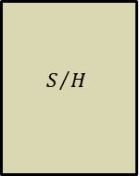
Control Block Diagram
100π
sin⁻¹
÷
f
$$\frac{dy}{dt}$$
-
x
$$J$$
+
+
+
2π
$$S/H$$
$$D$$
s

Slide 21
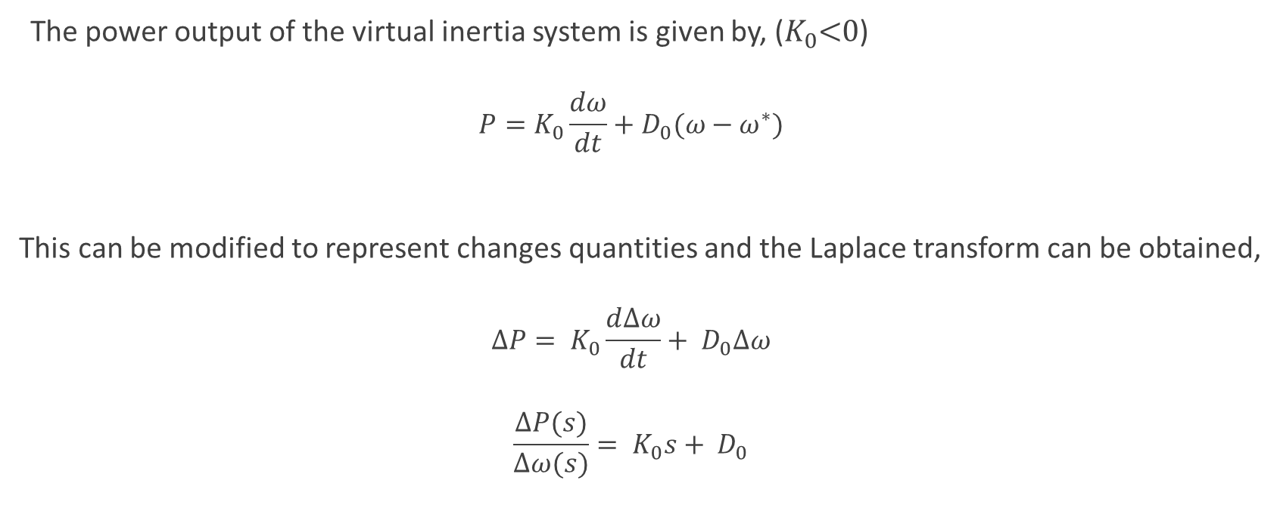
Effects on system stability
The power output of the virtual inertia system is given by, ($K_{0}$<0)
$$P=K_{0}\frac{dω}{dt}+D_{0}(ω−ω^{∗})$$
This can be modified to represent changes quantities and the Laplace transform can be obtained,
$$∆P= K_{0}\frac{d∆ω}{dt}+ D_{0}∆ω$$
$$\frac{∆P(s)}{∆ω(s)}= K_{0}s+ D_{0}$$

Slide 22
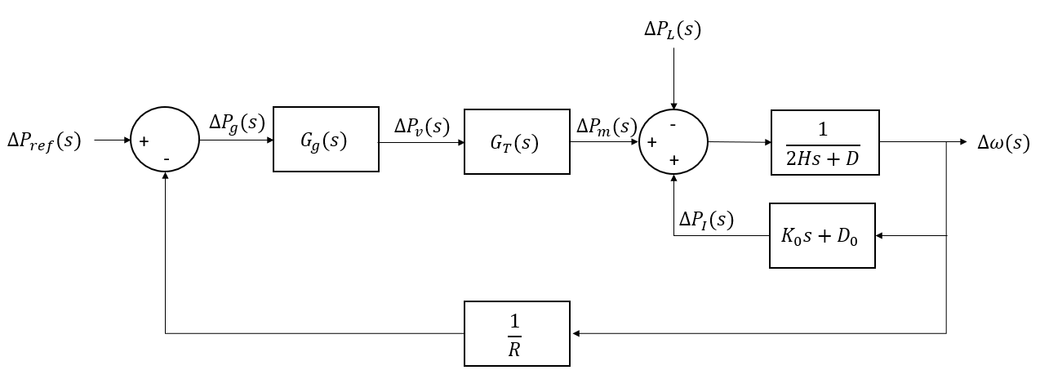
By incorporating the transfer function of virtual inertia system to the frequency control block diagram of an isolated power system, we obtain the following overall system block diagram.

Slide 23
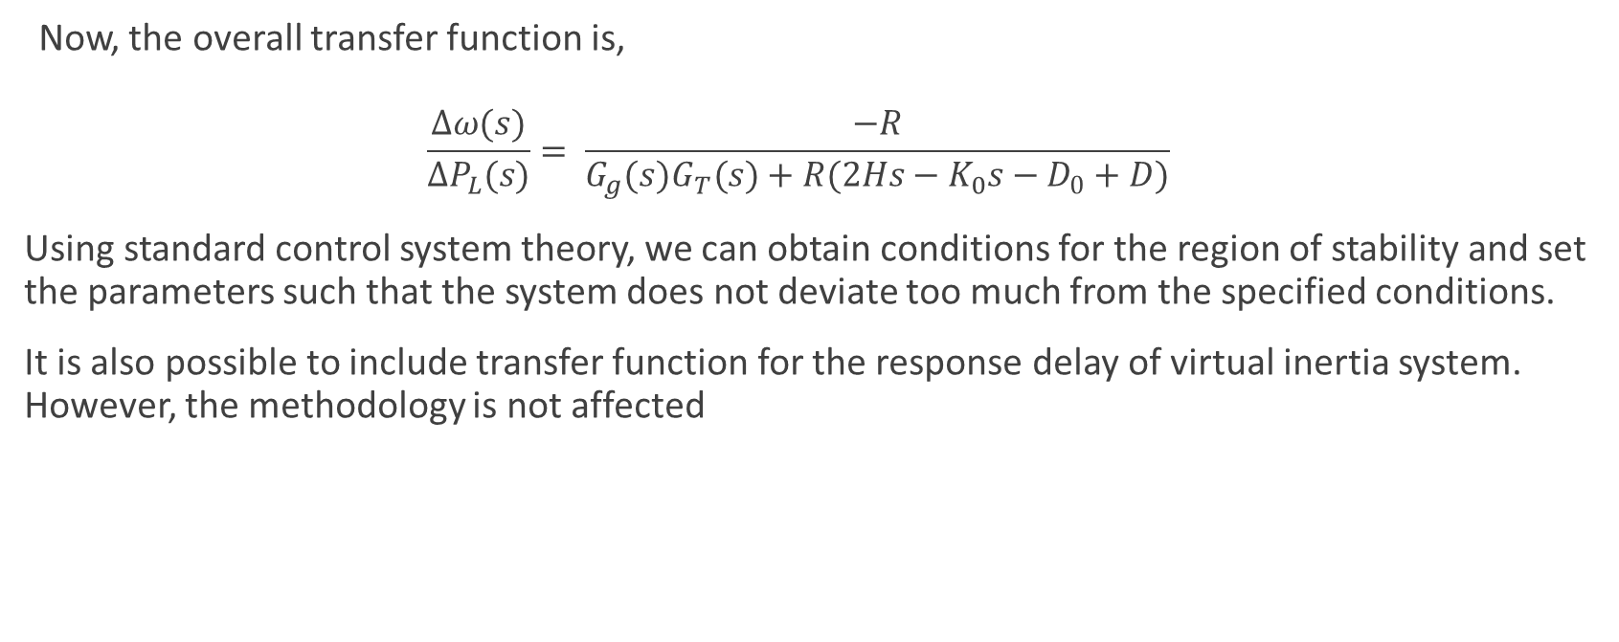
Now, the overall transfer function is,
$$\frac{∆ω(s)}{∆P_{L}(s)}= \frac{−R}{G_{g}(s)G_{T}(s)+R(2Hs−K_{0}s−D_{0}+D)}$$
Using standard control system theory, we can obtain conditions for the region of stability and set the parameters such that the system does not deviate too much from the specified conditions.
It is also possible to include transfer function for the response delay of virtual inertia system. However, the methodology is not affected

Slide 24
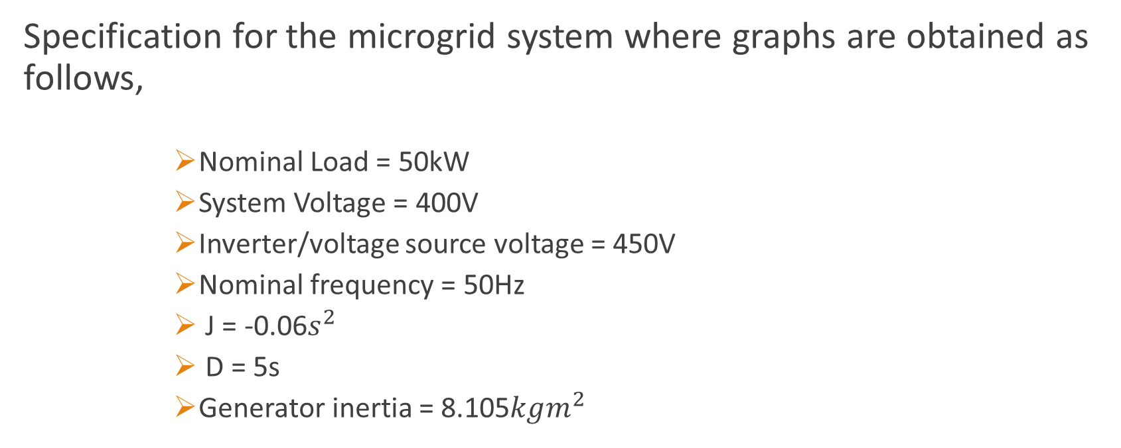
Results
Specification for the microgrid system where graphs are obtained as follows,
Nominal Load = 50kW
System Voltage = 400V
Inverter/voltage source voltage = 450V
Nominal frequency = 50Hz
J = -0.06$s^{2}$
D = 5s
Generator inertia = 8.105$kgm^{2}$

Slide 25
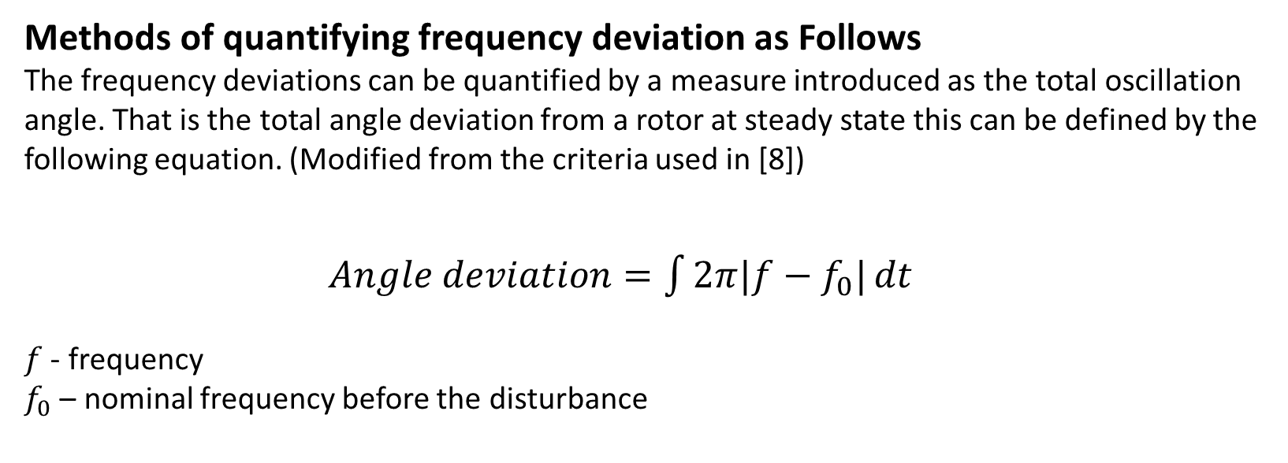
Methods of quantifying frequency deviation as Follows
The frequency deviations can be quantified by a measure introduced as the total oscillation angle. That is the total angle deviation from a rotor at steady state this can be defined by the following equation. (Modified from the criteria used in [8])
$Angle deviation=\int{2π|f−f_{0}|}dt$
$f$ - frequency
$f_{0}$ – nominal frequency before the disturbance

Slide 26
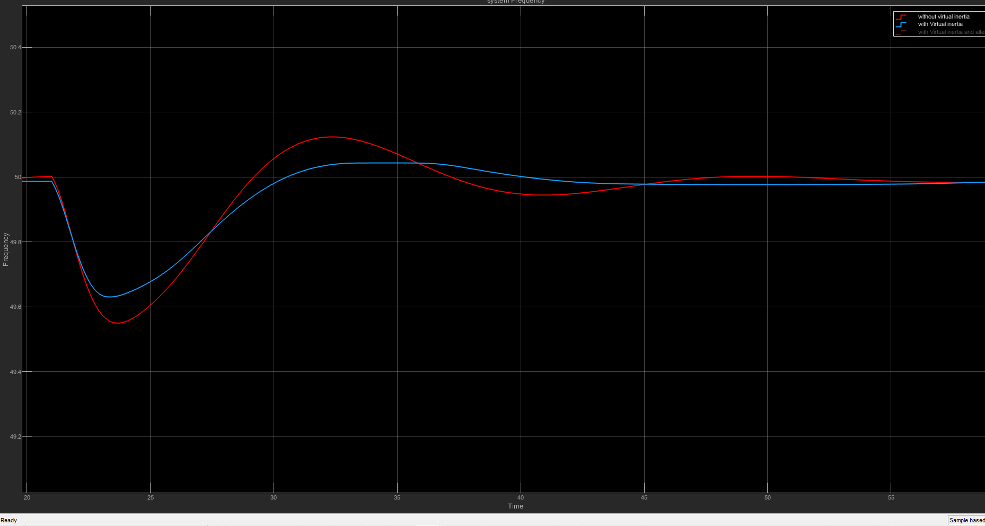
Results of the system for 5% disturbance from the nominal load (2.5kW)
With virtual inertia with constant J vs Without virtual inertia
Peak-peak frequency improvement with virtual inertia J = 39.02%
Parameters | With Virtual Inertia J | Without Virtual Inertia J
Lowest Point (Hz) | 49.63 | 49.55
Highest Point (Hz) | 50.04 | 50.12
Settling Time (s) | 7.490 | 13.183
Quantified Value (rad) | 16.97 | 20.35

Slide 27
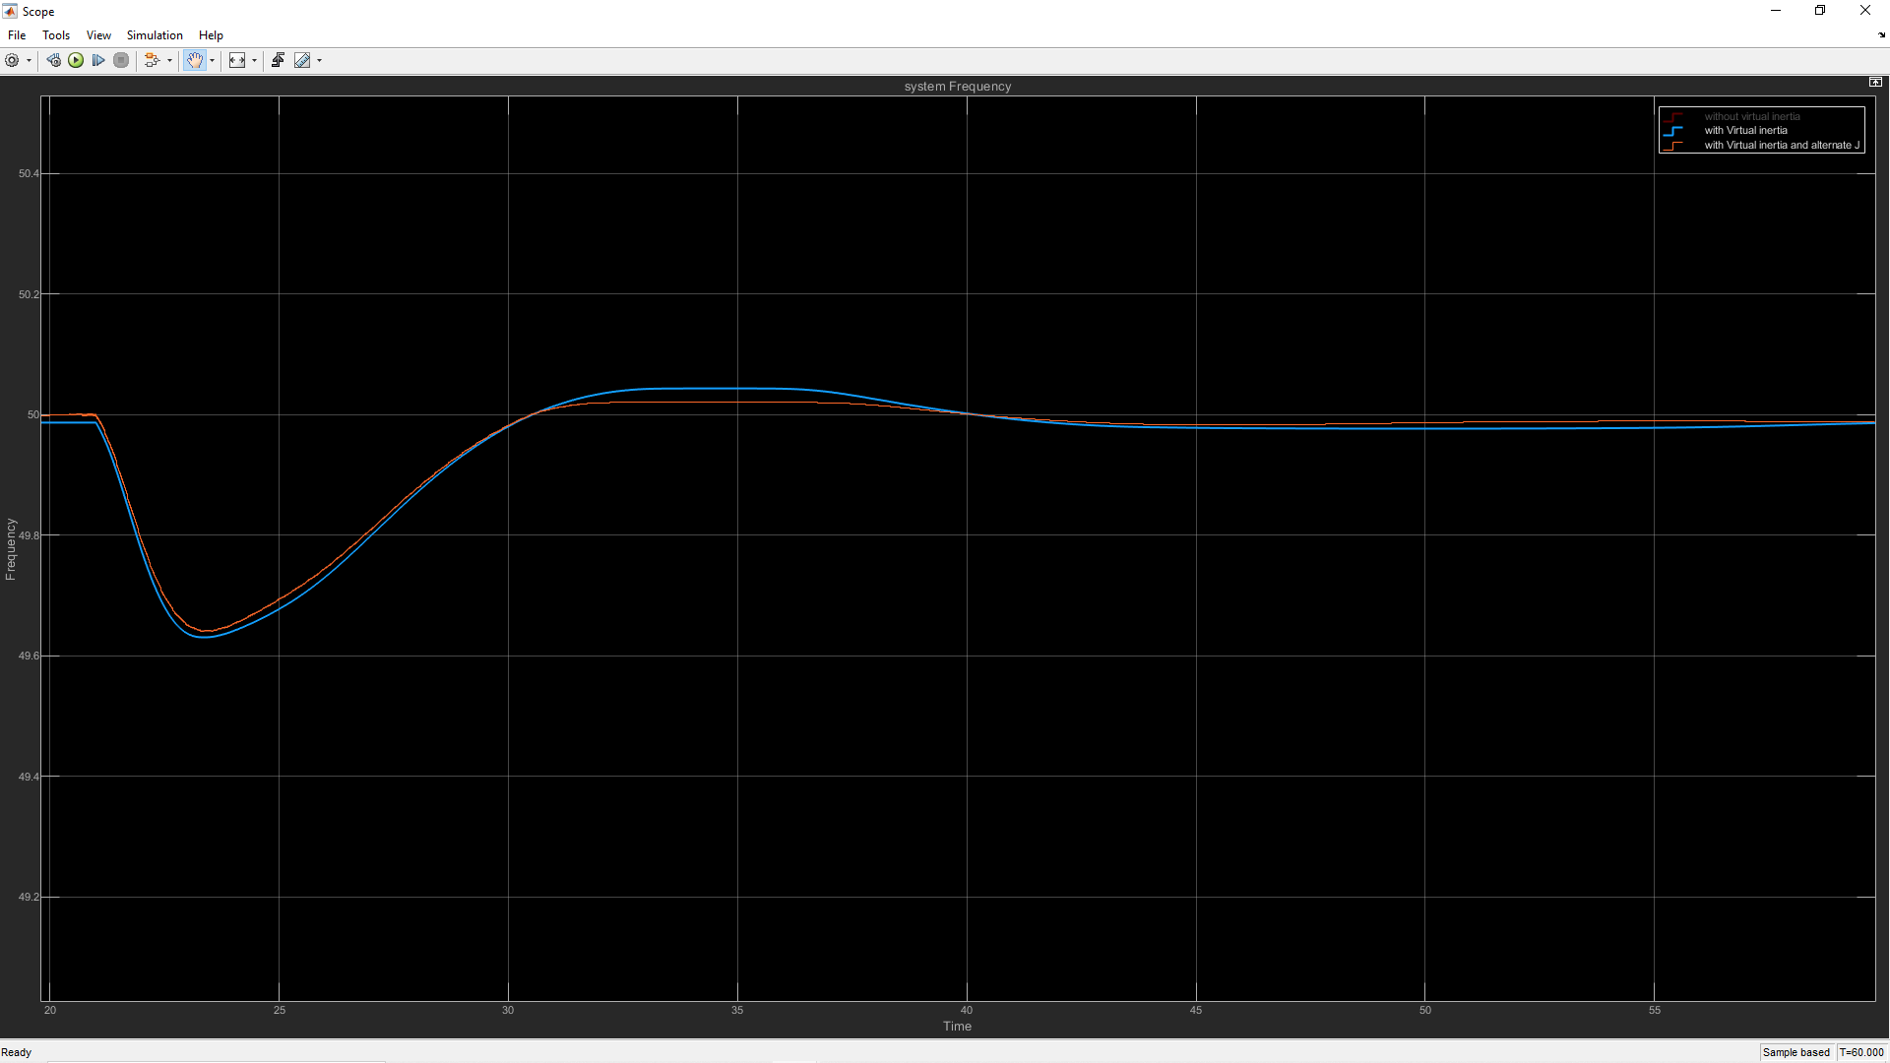
Results of the system for 5% disturbance from the nominal load (2.5kW)
Virtual inertia with Constant J vs Virtual inertia with Alternating J
Parameters | With Constant Virtual Inertia J | With Alternating Virtual Inertia J
Lowest Point (Hz) | 49.63 | 49.64
Highest Point (Hz) | 50.04 | 50.02
Settling Time (s) | 7.490 | 7.376
Quantified Value (rad) | 16.97 | 14.37
Peak-peak frequency improvement with alternating virtual inertia J = 7.89%

Slide 28
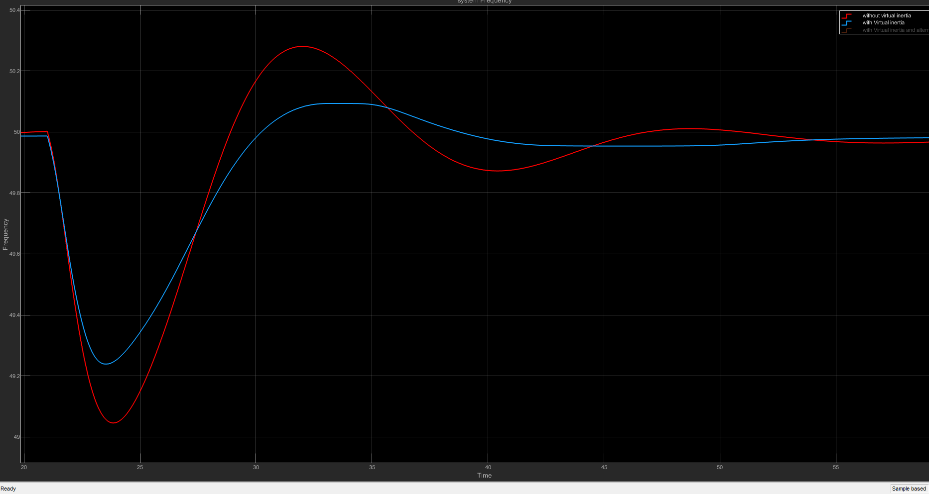
Results of the system for 10% disturbance from the nominal load (5kW)
With virtual inertia with constant J vs Without virtual inertia
Peak-peak frequency improvement with virtual inertia J = 44.71%
Parameters | With Virtual Inertia J | Without Virtual Inertia J
Lowest Point (Hz) | 49.24 | 49.05
Highest Point (Hz) | 50.09 | 50.28
Settling Time (s) | 8.222 | 21.682
Quantified Value (rad) | 32.57 | 43.07

Slide 29
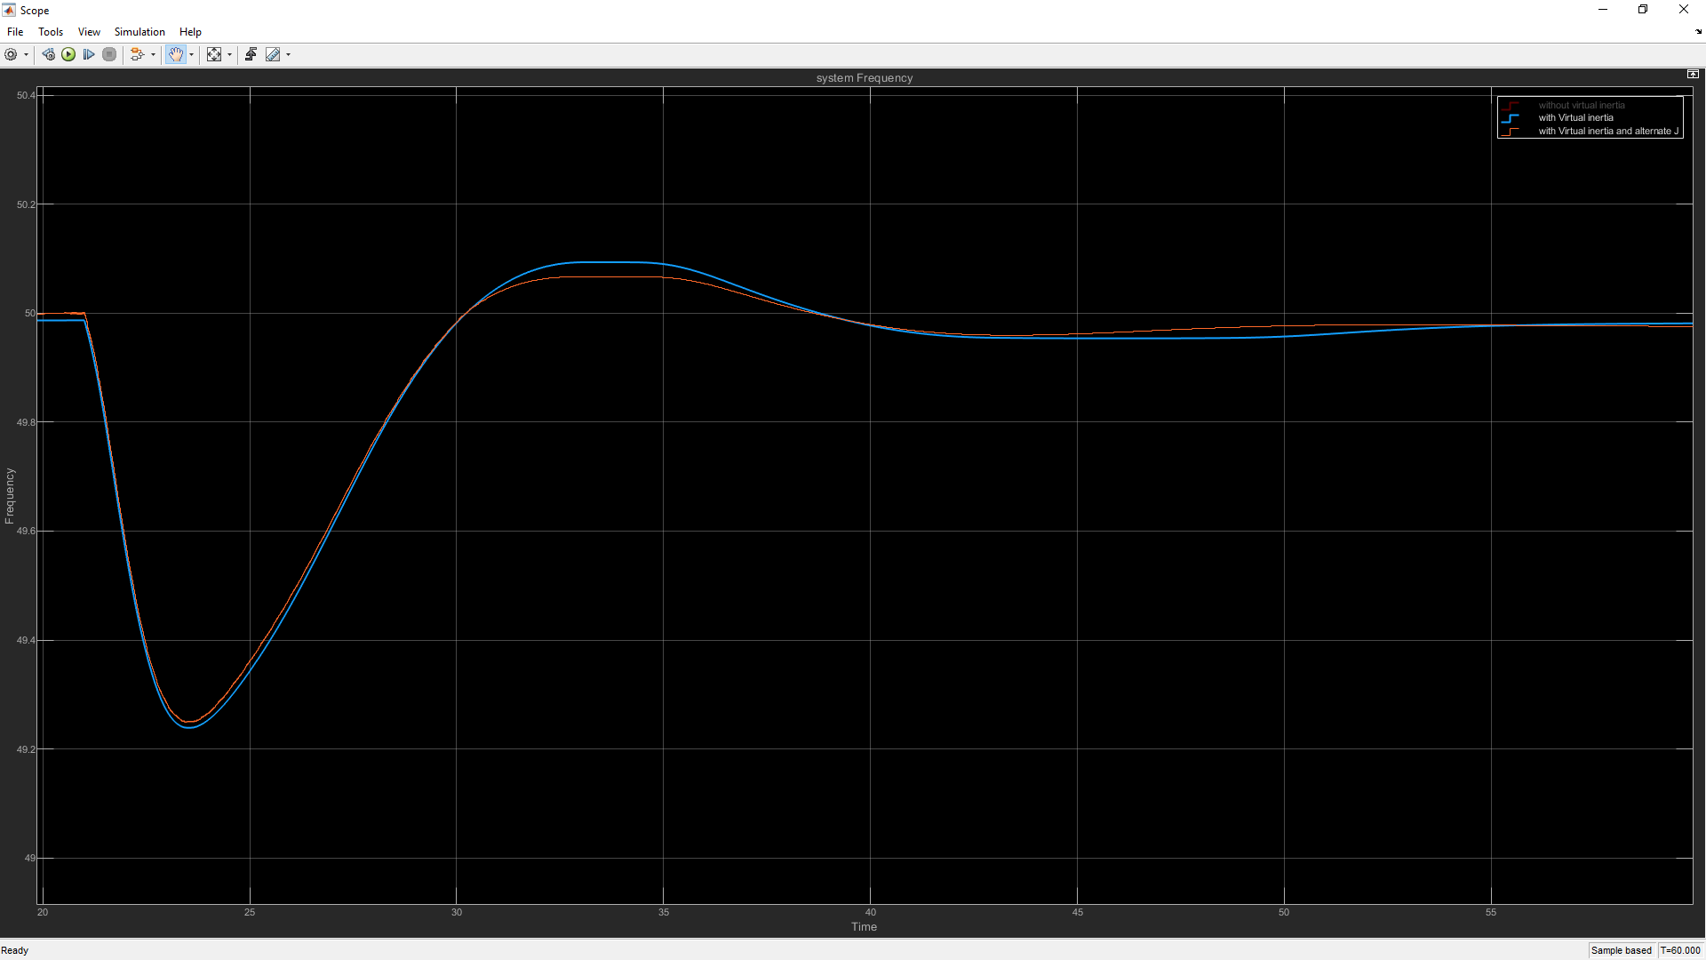
Results of the system for 10% disturbance from the nominal load (5kW)
Virtual inertia with Constant J vs Virtual inertia with Alternating J
Peak-peak frequency improvement with alternating virtual inertia J = 3.66%
Parameters | With Constant Virtual Inertia J | With Alternating Virtual Inertia J
Lowest Point (Hz) | 49.24 | 49.25
Highest Point (Hz) | 50.09 | 50.07
Settling Time (s) | 8.222 | 8.147
Quantified Value (rad) | 32.57 | 30.01

Slide 30
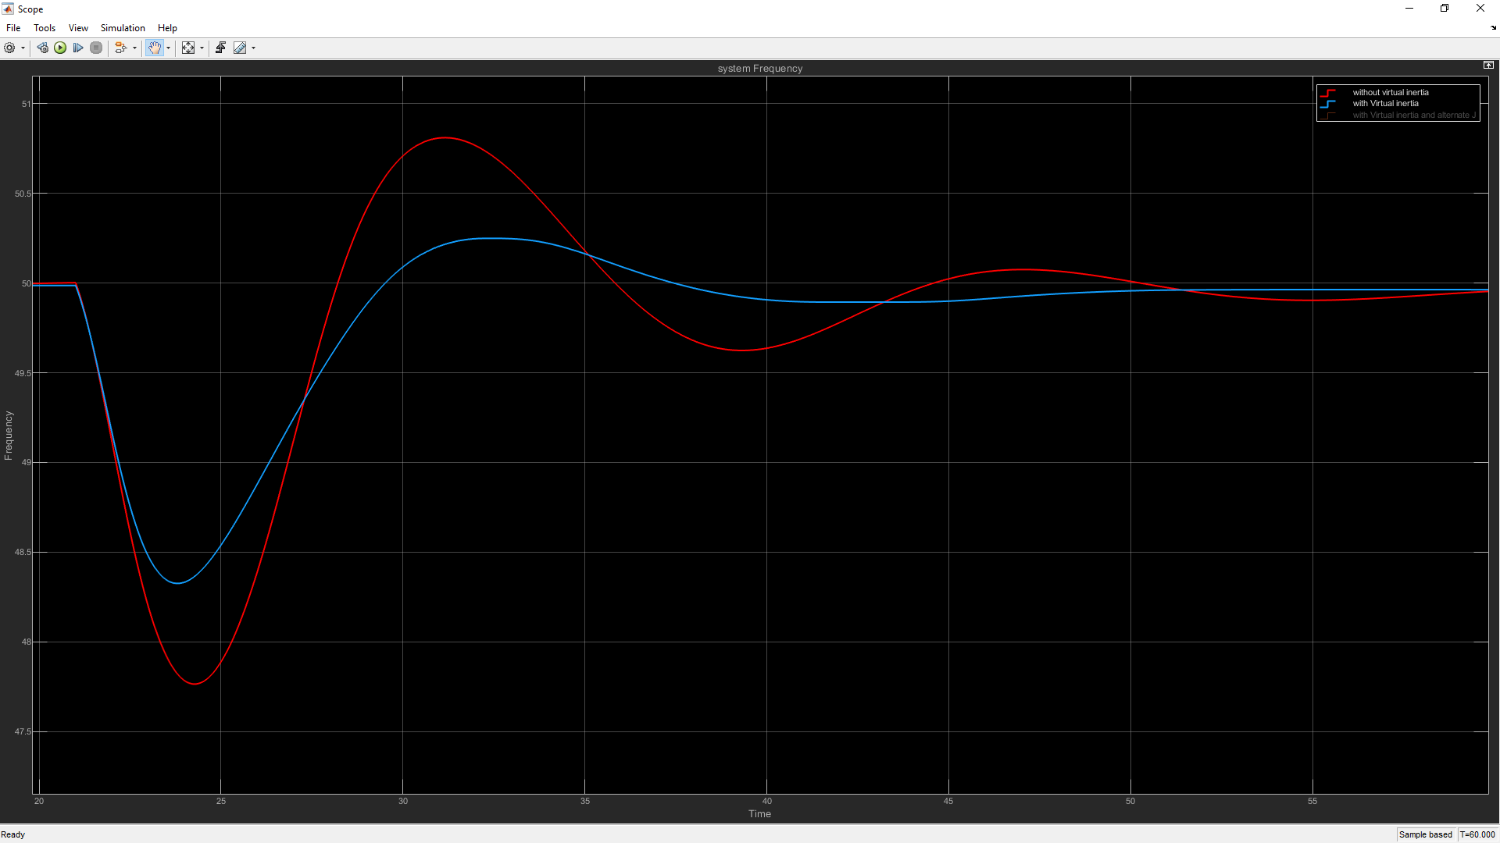
Results of the system for 20% disturbance from the nominal load (10kW)
virtual inertia with constant J vs Without virtual inertia
Peak-peak frequency improvement with virtual inertia J = 58.33%
Parameters | With Virtual Inertia J | Without Virtual Inertia J
Lowest Point (Hz) | 48.33 | 47.77
Highest Point (Hz) | 50.25 | 50.81
Settling Time (s) | 24.49 | 22.315
Quantified Value (rad) | 66.7 | 103.9

Slide 31
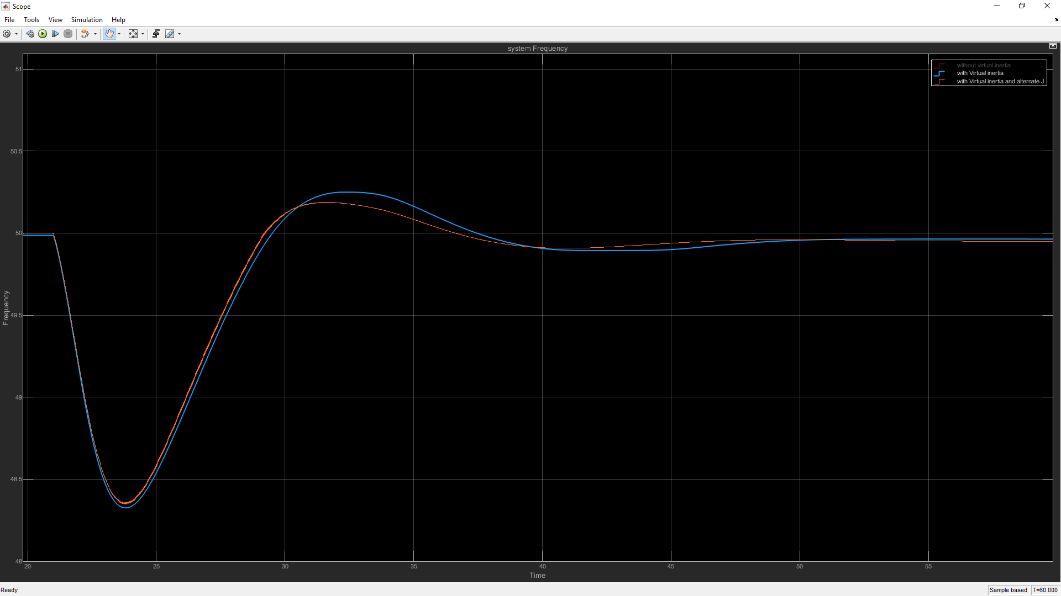
Results of the system for 20% disturbance from the nominal load (10kW)
Virtual inertia with Constant J vs Virtual inertia with Alternating J
Peak-peak frequency improvement with alternating virtual inertia J = 4.92%
Parameters | With Constant Virtual Inertia J | With Alternating Virtual Inertia J
Lowest Point (Hz) | 48.33 | 48.36
Highest Point (Hz) | 50.25 | 50.19
Settling Time (s) | 24.49 | 13.7
Quantified Value (rad) | 66.7 | 61.31

Slide 32
Analysis of results
Maximum value that can get the system unstable for a 20% disturbance (20% from the nominal Load) was taken by experimental method for a particular nominal Load Value.
Then the following graph can be plotted from the obtained data points.
Technically, for a particular load value any J value under the curve is feasible to get results without getting unstable.
To apply a safety margin, use 50% of the of the J value that the graph output.
So below equation gives optimal J value for this controller in LV system
J = Inertia constant
P= nominal Load
|J| = 0.5(6E-07P² + 0.0007P+ 0.1072)

Slide 33
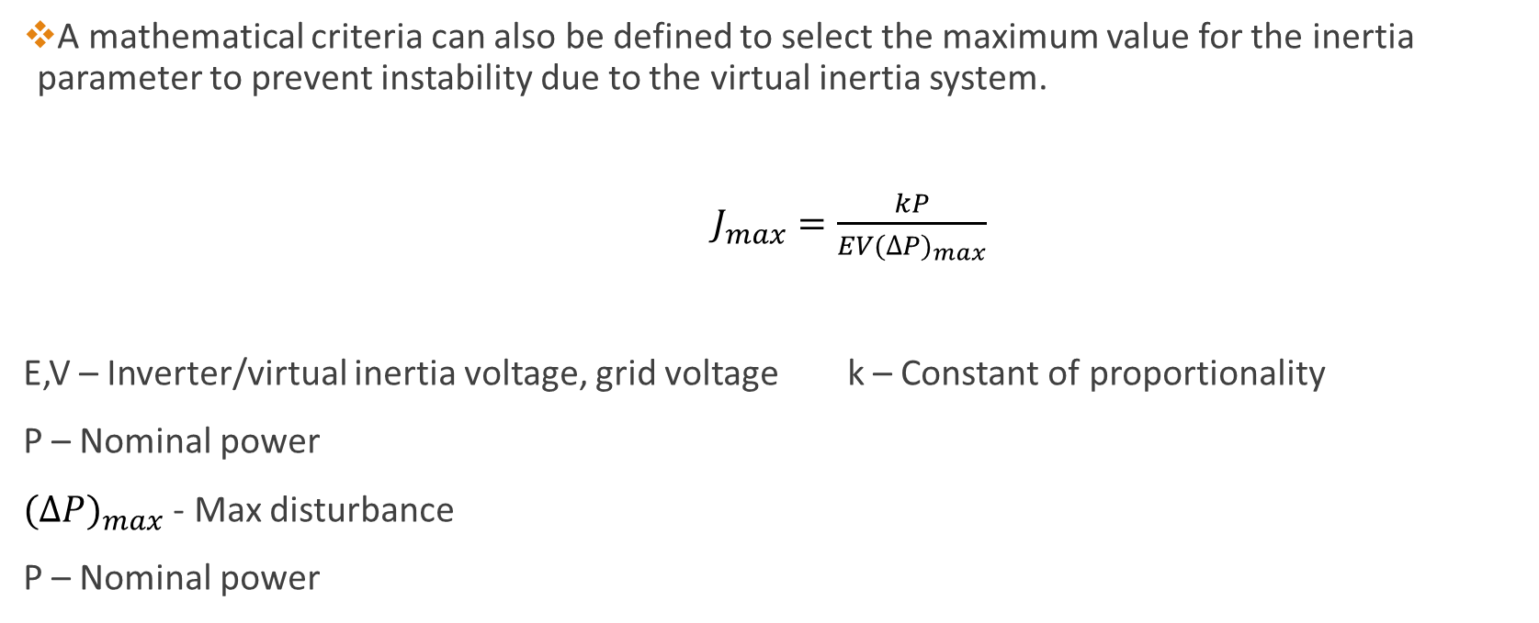
Analysis of results
A mathematical criteria can also be defined to select the maximum value for the inertia parameter to prevent instability due to the virtual inertia system.
$J_{max}=\frac{kP}{EV{(∆P)}_{max}}$
E,V – Inverter/virtual inertia voltage, grid voltage k – Constant of proportionality
P – Nominal power
${(∆P)}_{max}$ - Max disturbance
P – Nominal power

Slide 34
Results
Specification for the high-power system where graphs are obtained as follows,
Nominal Load = 120MW
System Voltage = 13.8kV
Inverter/voltage source voltage = 15kV
Nominal frequency = 50Hz
Disturbance = 10MW

Slide 35
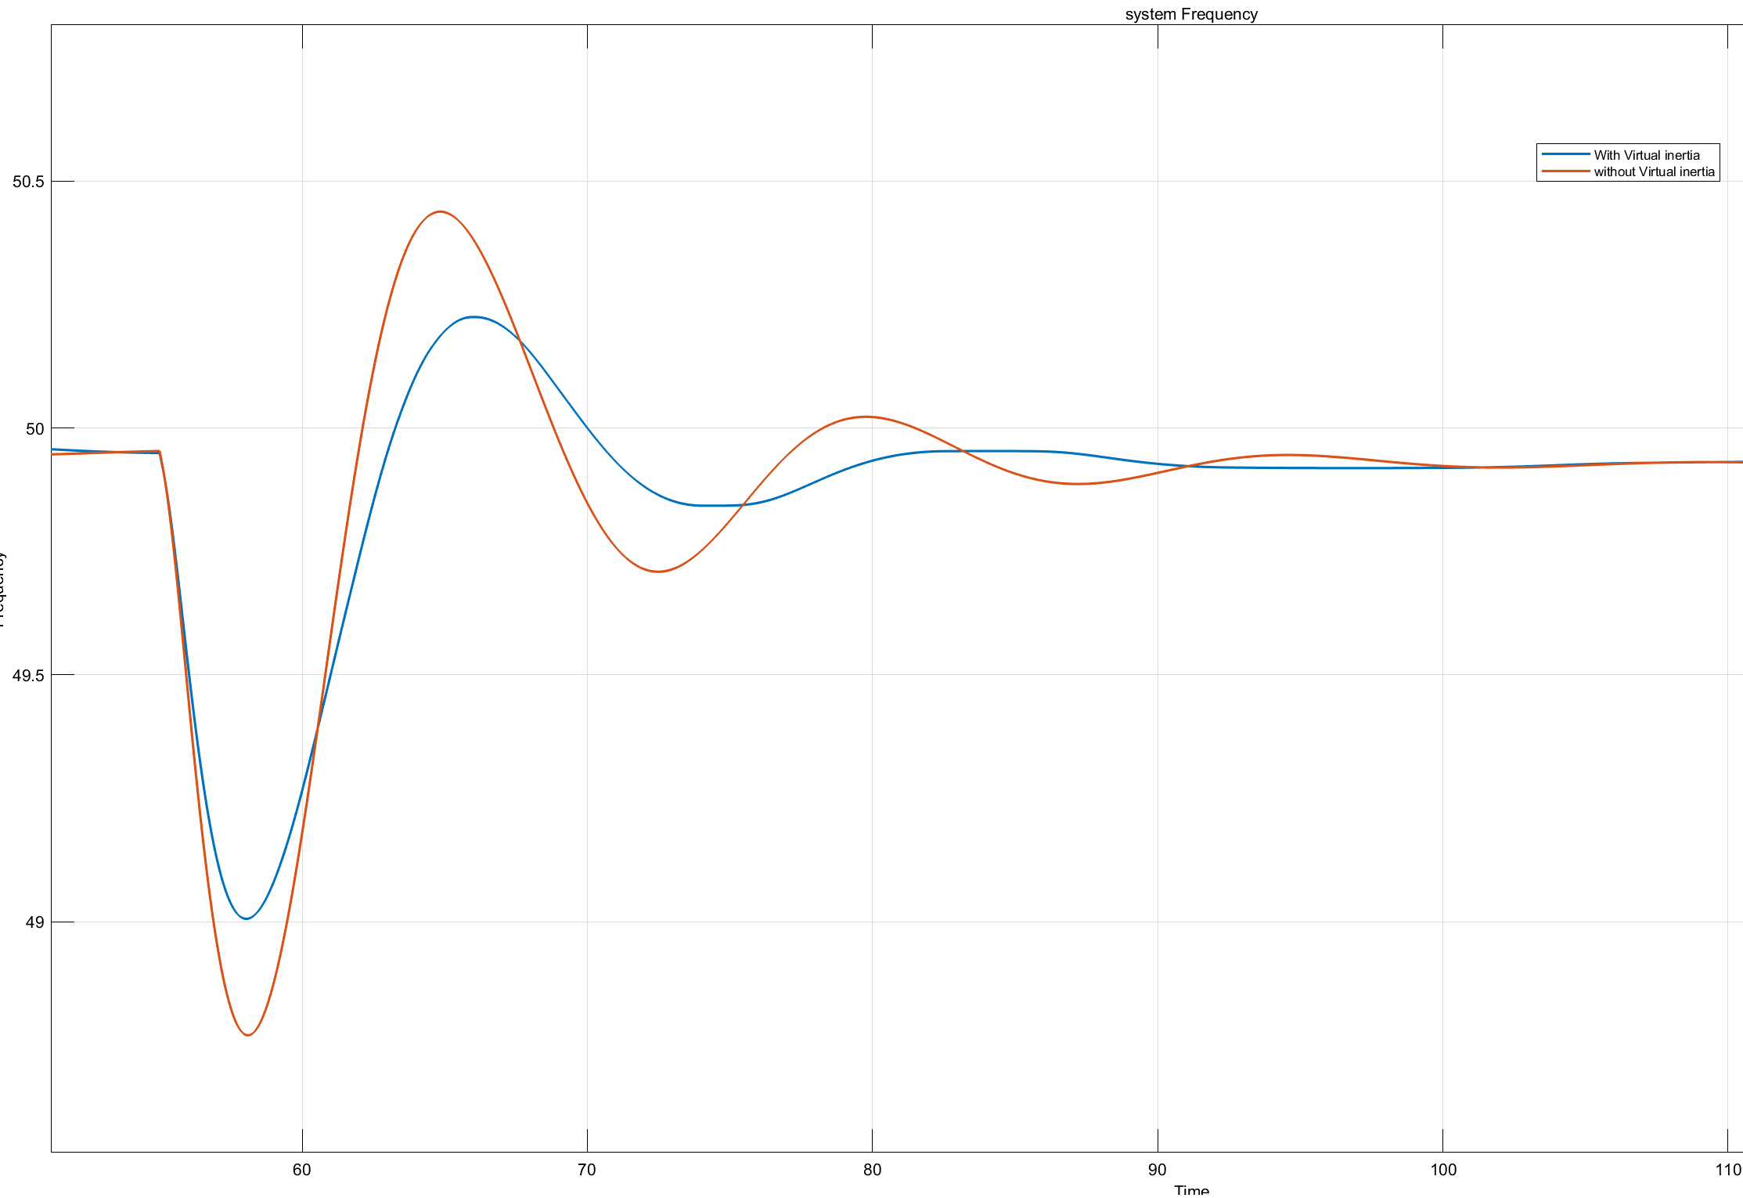
System frequency with virtual inertia and without virtual inertia
virtual inertia with constant J vs Without virtual inertia
Parameters | With Virtual Inertia J | Without Virtual Inertia J
High Peak Frequency (Hz) | 50.23 | 50.44
Low Peak Frequency (Hz) | 49.01 | 48.77
Settling Time (s) | 23.78 | 34.94
Peak-peak frequency improvement with virtual inertia J = 26.95%
Settling time improvement with virtual inertia J = 31.94%

Slide 36
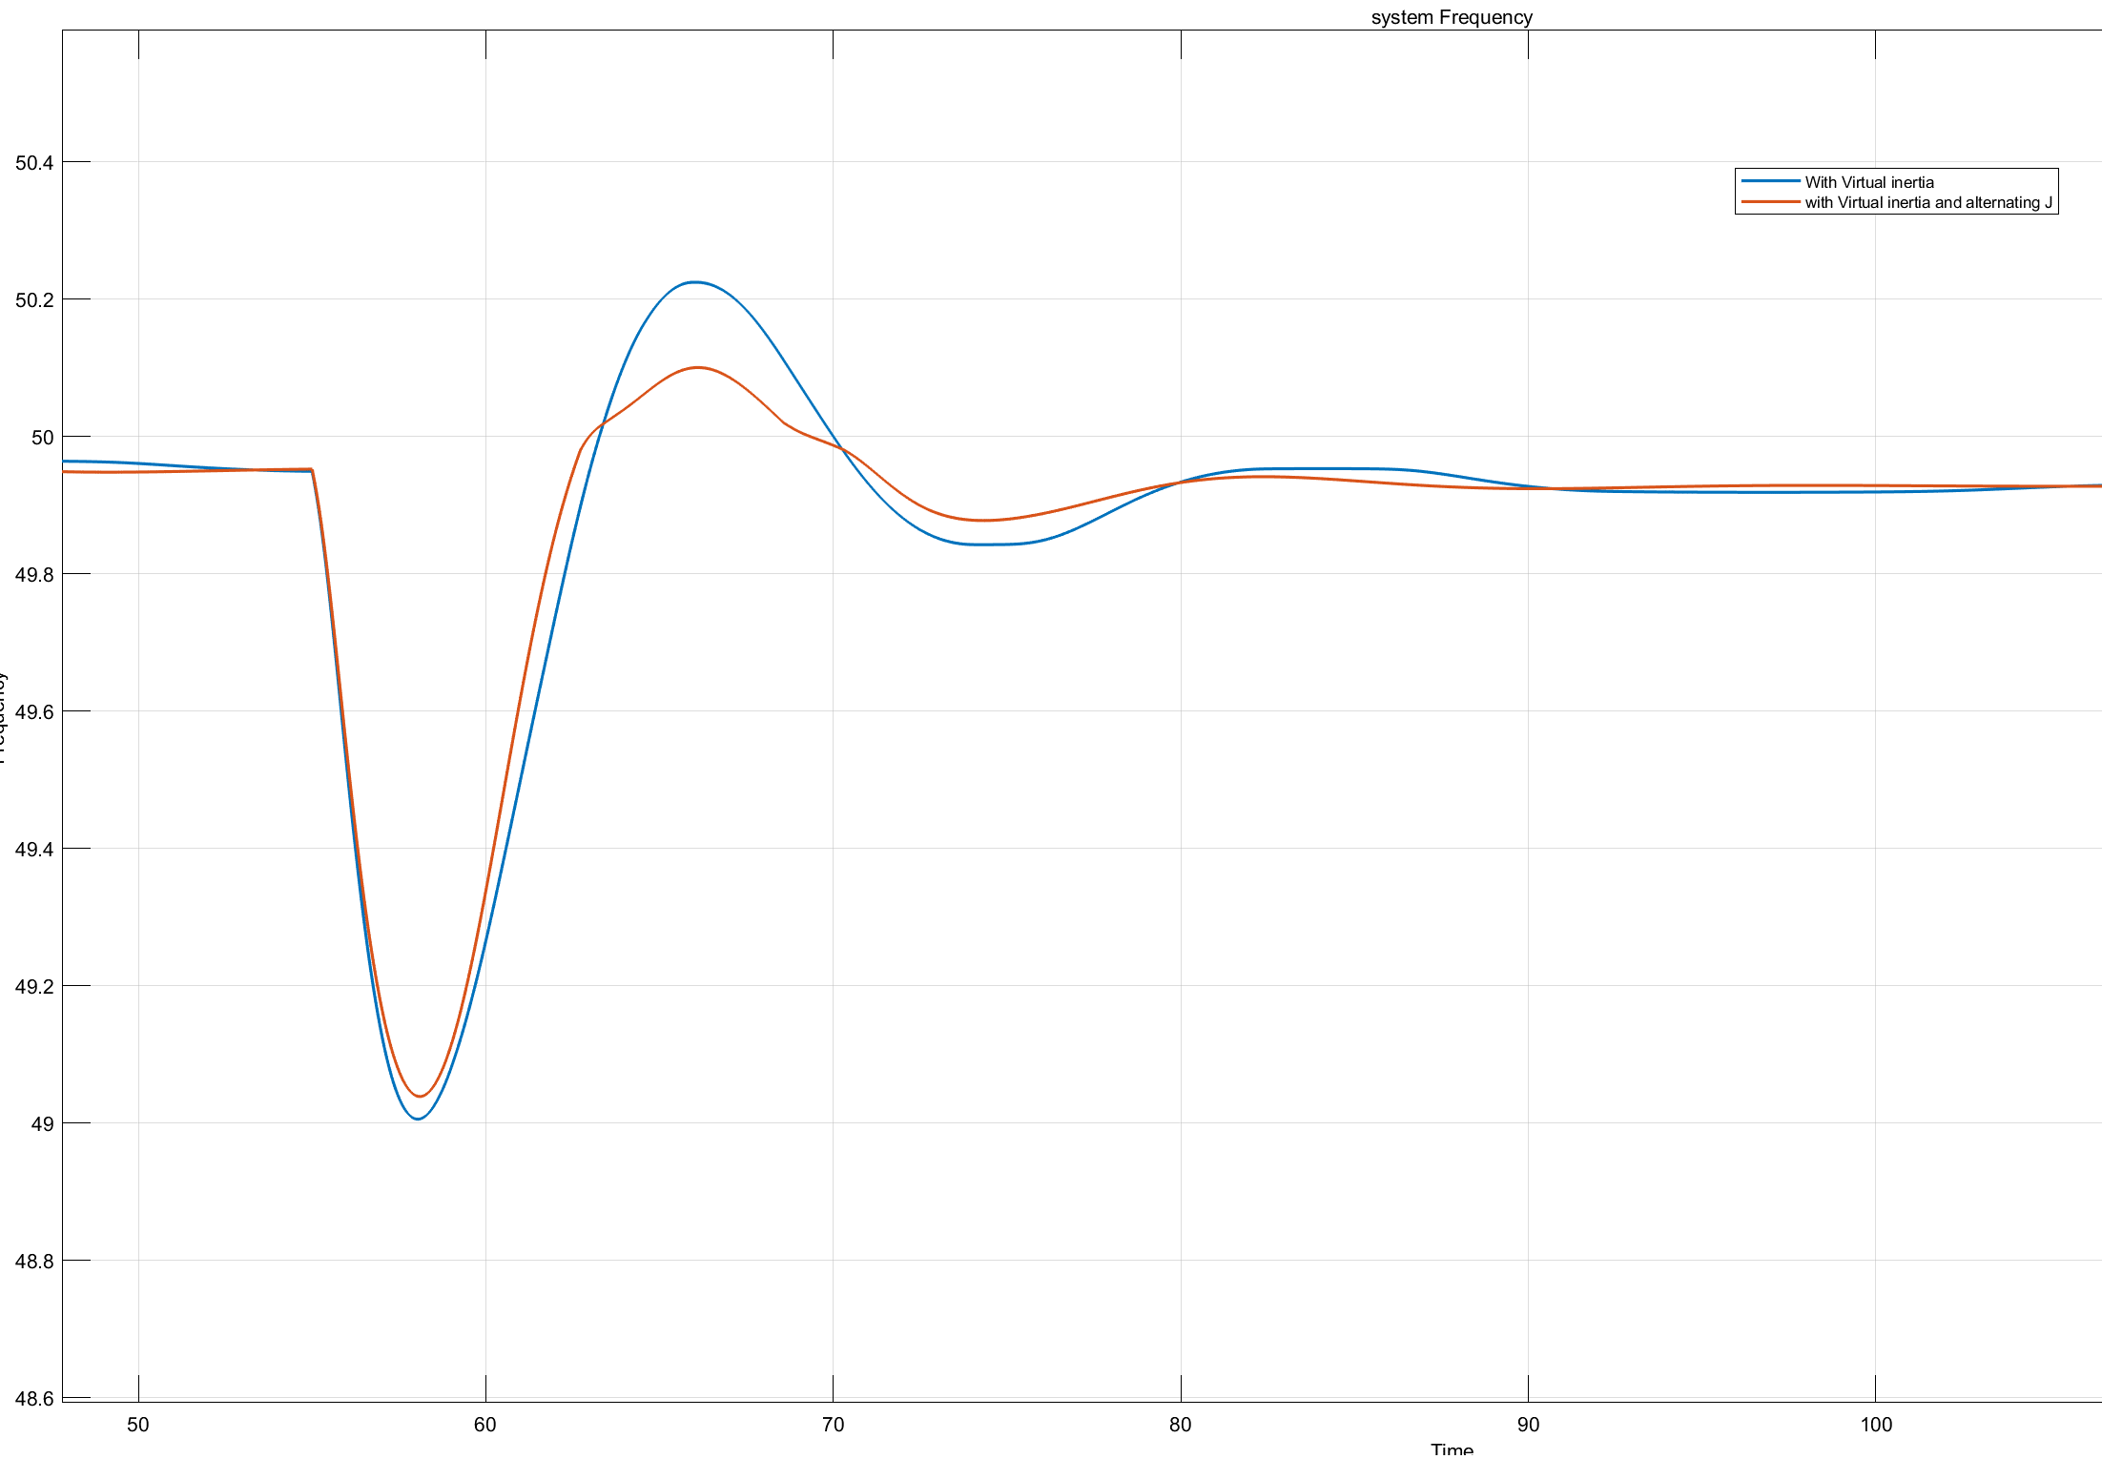
System frequency with constant virtual inertia and alternating virtual inertia
Virtual inertia with Constant J vs Virtual inertia with Alternating J
Parameters | With Constant Virtual Inertia J | With Alternating Virtual Inertia J
High Peak Frequency (Hz) | 50.23 | 50.09
Low Peak Frequency (Hz) | 49.01 | 49.04
Settling Time (s) | 23.78 | 20.28
Peak-peak frequency improvement with alternating virtual inertia J = 13.93%
Settling time improvement with alternating virtual inertia J = 14.72%

Slide 37
Conclusions so far…..
A virtual inertia system with the control strategy discussed here is effective in reducing frequency fluctuations compared to a system without it.
The inertia parameter of the virtual inertia control determines the power injected to the grid.
However, increasing this parameter can lead to instability due to the injected amount of power.
Therefore, an upper limit exists for the magnitude of the inertia parameter of the controller.
There is an improvement in variable inertia cases compared to keeping a constant inertia.

Slide 38
Project timeline
August
September
December
January
February
March
April
May
October
November
June
Simulation finetuning & Improve Robustness of controller
Study the theoretical background
Modelling the components
Design the Control system
Gather related data.
Writing the research paper

Slide 39
References that referred so far…
[1]From research paper - J. Alipoor, Y. Miura and T. Ise, "Power System Stabilization Using Virtual Synchronous Generator With Alternating Moment of Inertia," in IEEE Journal of Emerging and Selected Topics in Power Electronics, vol. 3, no. 2, pp. 451-458, June 2015, doi: 10.1109/JESTPE.2014.2362530.
[2]M. A. Torres L., L. A. C. Lopes, L. A. Morán T. and J. R. Espinoza C., "Self-Tuning Virtual Synchronous Machine: A Control Strategy for Energy Storage Systems to Support Dynamic Frequency Control," in IEEE Transactions on Energy Conversion, vol. 29, no. 4, pp. 833-840, Dec. 2014, doi: 10.1109/TEC.2014.2362577.
[3]J. Liu, Y. Miura, H. Bevrani and T. Ise, "Enhanced Virtual Synchronous Generator Control for Parallel Inverters in Microgrids," in IEEE Transactions on Smart Grid, vol. 8, no. 5, pp. 2268-2277, Sept. 2017, doi: 10.1109/TSG.2016.2521405.
[4] Chen H, Cong TN, Yang W, Tan C, Li Y, Ding Y. Progress in electrical energy storage system: A critical review. Progress in Natural Science. 2009;19(3):291-312

Slide 40
References that referred so far…
[5] Cabrane Z, Ouassaid M, Maaroufi M. Analysis and evaluation of battery-supercapacitor hybrid energy storage system for photovoltaic installation. International Journal of Hydrogen Energy. 2016;41(45):20897-20907
[6] Zarina P, Mishra S, Sekhar P. Photovoltaic system based transient mitigation and frequency regulation. In: 2012 Annual IEEE India Conference (INDICON); IEEE. 2012. pp. 1245-1249
[7]Xiaodong Liang, and Chowdhury Andalib Bin Karim ‘Virtual Synchronous Machine Method in Renewable Energy Integration
[8] M.P.N van Wesenbeeck1 , S.W.H. de Haan , Senior member, IEEE, P. Varela and K. Visscher ‘Grid Tied Converter with Virtual Kinetic Storage’
[9] M. Surprenant, I. Hiskens and G. Venkataramanan, ‘Phase locked loop control of inverters in a microgrid’

Slide 41
Thank You..!

